Slide 1
Your Microphone is Muted:
Navigating Virtual Settlement Conferences
July 16, 2020 FFA Presentation
Honorable S. Kato Crews, U.S. District Court for Colorado
Dipak Patel, Esq., Ciancio Ciancio Brown, P.C.
Deborah Yim, Esq., Primera Law Group, LLC
Notes:
Be specific and direct in the title. Use the subtitle to give the specific context of the speech.
-The goal should be to capture the audience’s attention which can be done with a quote, a startling statistic, or fact. It is not necessary to include this attention getter on the slide.

Slide 2
Agenda
Procedures for Settlement Conferences in U.S. District Court
Benefits of Virtual Settlement Conferences
Practical Tips for Remote Settlement Conferences
Ethical Considerations
Notes:
Use the background points to post details that are not common knowledge, or that the audience will need to understand the context of the speech.
-Do not read these main points from the PowerPoint, instead elaborate on these points during the speech.

Slide 3
Settlement Conferences in U.S. District Court
Procedures in U.S. District Court
Each Magistrate Judge’s procedures may be a little different. Check with your judicial officer.
Typical parameters likely to be same (e.g., confidential settlement statements; pre-conference calls with counsel; appearance of persons with settlement authority)
Differences with virtual format
Use of documents
Downtime
Finalizing material terms when agreement is reached

Slide 4
Settlement Conferences in U.S. District Court
Other Considerations:
Is a virtual settlement conference now required if a settlement conference is requested by the parties?
Future of settlement conferences after COVID-19 & in years ahead
Effectiveness of virtual settlement conferences from a judge’s perspective

Slide 5
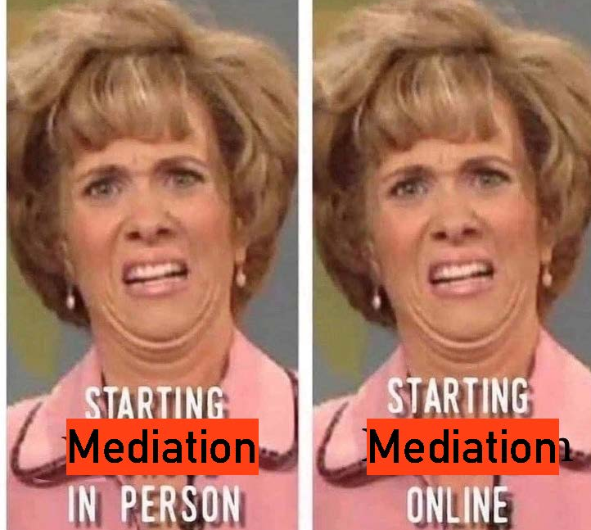
Benefits of Virtual Settlement Conferences
Cost savings
Reduction of travel
Ease of scheduling sessions
Reduction of transaction costs
Ease of sharing documents
Eliminates risks of parties interfacing in common areas, particularly for acrimonious cases
Reduces legal games (e.g., storming out of room)
Client has comfort with surroundings
Recent mediation example

Slide 6
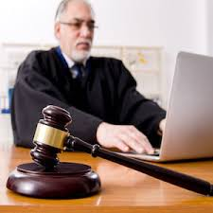
Practical Tips for Remote Conferences
Prior to Mediation: Prepare, Prepare, Prepare!
Pre-conference call between counsel and judicial officer: Be sure & discuss logistics:
Who will “host” be? (Does Zoom pro account need to be purchased?)
Will there be password protection to enter meeting for security purposes? (some platforms like Zoom require the password)
Who will be in attendance?
Only parties and attorneys. Temptation to spring new “players” when parties are at home and no travel is required.
Third parties need permission from other side.

Slide 7
Practical Tips for Remote Conferences
Will there be breakout rooms for caucusing? Waiting room?
Confidentiality & privacy rules
How will documents be shared during mediation? Screen sharing must be enabled by “host”
No recording by audio or video technology
Consider mediation agreement to ensure privacy/confidentiality; only attendance of third parties; and no recording
Exchange cell phone numbers in case tech problems arise
Backup plan if tech problems?

Slide 8
Practical Tips for Remote Conferences
Preparing your client
Acquaint your client with the settlement conference process as you would for a regular, non-virtual conference.
Have client prepare a few words to share his/her story
Acclimate your client to videoconferencing logistics & etiquette (likely first time for non-institutional client)
Understand all conference ground rules discussed with magistrate judge beforehand (e.g., no recording).
Practice test run through is crucial, especially if you will not be in same location as your client.
Need laptop, desktop, smartphone or tablet (desktop preferred) with device’s power sources and working microphone & camera.

Slide 9
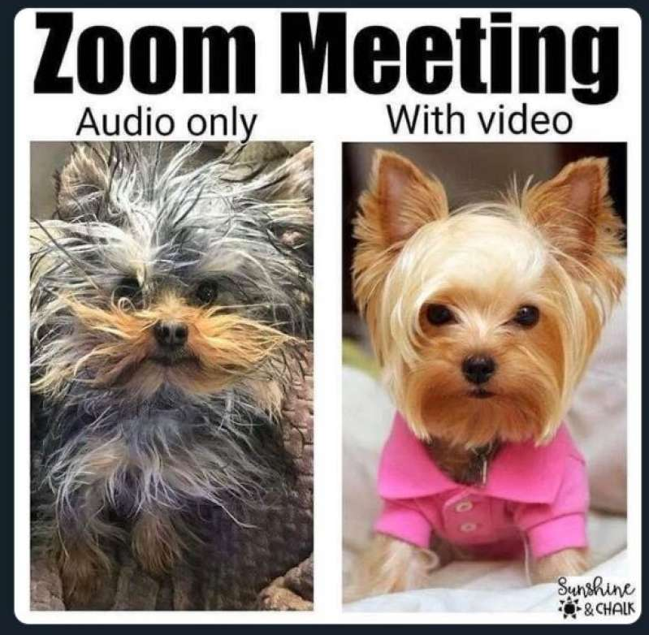
Practical Tips for Remote Conferences
Download app for virtual platform.
Check internet speed: 40 Mbps. Wired connection preferred over wireless.
If bad sound quality: cut video or leave video, call in, and mute computer to avoid echo.
Find secure location with secure internet connection
Ensure appropriate video background
Upload appropriate profile photo

Slide 10
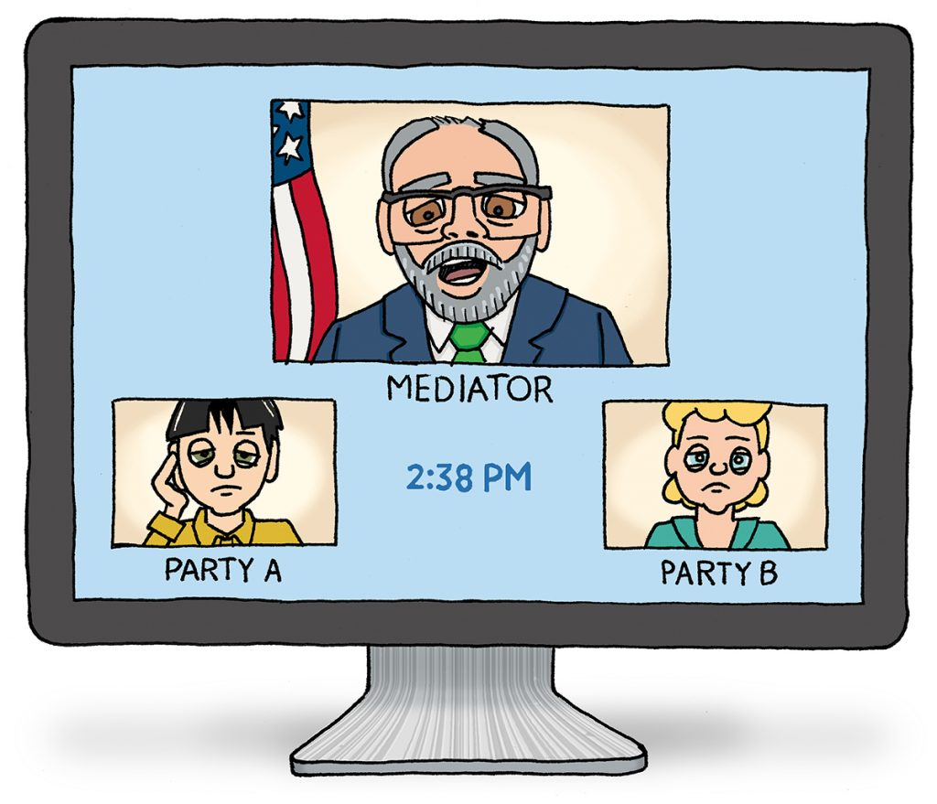
Practical Tips for Remote Conferences
Use “rename” function to change what’s displayed for client name (e.g., “Johnny’s iPhone” vs. “John Smith”)
Use of “gallery view” versus “speaker view”
Understanding use of breakout rooms versus main meeting room
Importance of mute button
If you are in same room as client and using two separate devices, mute one to avoid annoying sound feedback.
Camera positioning
Understand facial expressions will be seen by everyone in gallery view – be careful
Dress code: consider if your full body will be shown

Slide 11
Practical Tips for Remote Conferences
Discuss use of “raise hand” feature
Chat room is not private!
Agree on how to communicate with each other during videoconference (e.g., cell phone, email, text, Google chat)
Make sure client gets you all documents for screen sharing (attorney screen shares instead of client to avoid accidental over-sharing)
Make sure client has all items needed to be comfortable including water, kleenex, etc.

Slide 12
Practical Tips for Remote Conferences
Preparing yourself
Review virtual platform’s terms of service and policies such as re: privacy
Ensure you follow all the above re videoconferencing logistics & etiquette
Consider using two computers to avoid toggling between note-taking/research & minimizing video platform
Have all documents for screen sharing ready to go
Have draft settlement agreement template ready

Slide 13
Practical Tips for Remote Conferences
During Mediation
Ensure all privacy/confidentiality rules are being observed.
Downtime
Ensure client takes breaks
Open up separate Zoom room for discussions with client if no breakout rooms
Use a white board to go over numbers & calculations

Slide 14
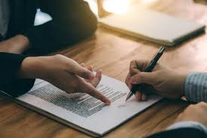
Practical Tips for Remote Conferences
Finalizing settlement
Benefit of same day execution of agreement
Consider DocuSign for efficiency
Screen share agreement, redline at same time & go over terms with client

Slide 15
Ethical Considerations
All of the usual ethics rules still apply:
Colo.RPC 1.2(a) re: authority to settle
“A lawyer shall abide by a client's decision whether to settle a matter.”
Colo.RPC 1.4 re: communication
Comment [2]: “[A] lawyer who receives from opposing counsel an offer of settlement in a civil controversy . . . must promptly inform the client of its substance unless the client has previously indicated that the proposal will be acceptable or unacceptable or has authorized the lawyer to accept or to reject the offer.”
Comment [5]: “[W]hen there is time to explain a proposal made in a negotiation, the lawyer should review all important provisions with the client before proceeding to an agreement.”

Slide 16
Ethical Considerations
Colo.RPC 1.6(a) re: confidentiality
“A lawyer shall not reveal information relating to the representation of a client unless the client gives informed consent, the disclosure is impliedly authorized in order to carry out the representation, or the disclosure is permitted by paragraph (b) [allowing a lawyer to reveal information when the lawyer reasonably believes it is necessary to prevent death or substantial bodily harm, fraud, or to comply with law or a court order].”
Colo.RPC 1.8(g) re: aggregate settlements
A lawyer who represents two or more clients shall not participate in making an aggregate settlement of the claims of or against the clients . . . unless each client gives informed consent, in a writing signed by the client. The lawyer's disclosure shall include the existence and nature of all the claims or pleas involved and of the participation of each person in the settlement.”

Slide 17
Ethical Considerations
Colo.RPC 4.1 re: truthfulness
“In the course of representing a client a lawyer shall not knowingly: (a) make a false statement of material fact or law to a third person; or (b) fail to disclose a material fact to a third person when disclosure is necessary to avoid assisting a criminal or fraudulent act by a client, unless disclosure is prohibited by Rule 1.6.”

Slide 18
Ethical Considerations
Additional Ethics Considerations
Make sure client understands basic ground rules like not recording or taking a snapshot of any portion of conference; or not trying to access the conference at unassigned times
Make sure no others are in the room with client
Review & be familiar with privacy, security, terms of service and related policies of virtual platform being used, and advise client.
See Colo.RPC 1.1 (“A lawyer shall provide competent representation to a client. Competent representation requires the legal knowledge, skill, thoroughness and preparation reasonably necessary for the representation.”)

Slide 19
Resources for Online Mediations
Click on each link to access the sources:
10 Recommended Tips for Remote Mediations (Lexology)
Tips for Successful Mediations Using Zoom Videoconferencing (Ret. Judge Suzanne Segal)
How To Prepare For A Virtual Mediation (Planet Depos)
Helpful Hints for Using Zoom for Remote Mediations (South Carolina Bar Dispute Resolution)
Ethical Considerations Zoom Mediations CLE video (Colorado Bar Association)

Slide 20
Thank you! Questions can be directed to:
Magistrate Judge S. Kato Crews (Crews_Chambers@cod.uscourts.gov)
Dipak Patel, Esq. (dipakpatel@colo-law.com)
Deborah Yim, Esq. (dyim@primeralaw.com)

