Slide 1
Use of Technology to Effectively Communicate Information in Court
UNITED STATES DISTRICT COURT FOR DISTRICT OF COLORADO

Slide 2
Key Points about Courtroom Technology
Need to use it.
  Jurors and judges expect it.
  Allows for more efficient and effective communication of ideas.
Better to not use it than use it badly.
Get a good Technician/Paralegal
Practive Practice Practice!
  And check for spelling errors.

Slide 3
Three Trial Uses for Technology
Opening/Closing—Prepared Slides.
Presentation of Evidence-- Dynamic/Interactive.
Replacing Notebooks/Binders—for easy exhibit access/cross-examination.
CRITICAL—JUST TOOLS—NEED TO THINK ABOUT THE CONTENT—THE STORY

Slide 4
PowerPoint Basics
Background and Font Color

Slide 5
White on Blue

Slide 6
White on Red

Slide 7
White on Green

Slide 8
Yellow on Blue

Slide 9
Decorative Backgrounds

Slide 10
Decorative Backgrounds

Slide 11
Lists
Use few words
Display points one after another
Use simple transitions

Slide 12
Who is more credible?
Witness No. 1
Witness No. 2
Met with Mr. Smith on July 2, July 6, August 22, and September 7.
Familiar with standards for similar products, applied such standards over 20 times.
Took contemporaneous notes whose accuracy is not challenged.
Has never met Mr. Smith or anyone with actual experience.
Has never applied the standards at issue and could not identify any relevant experience.
Did not read Witness No. 1’s notes.

Slide 13
Who is more credible?
Witness No. 1
Witness No. 2
Met with Mr. Smith on July 2, July 6, August 22, and September 7.
Familiar with standards for similar products, applied such standards over 20 times.
Took contemporaneous notes whose accuracy is not challenged.
Has never met Mr. Smith or anyone with actual experience.
Has never applied the standards at issue and could not identify any relevant experience.
Did not read Witness No. 1’s notes.

Slide 14
Lists
Don’t use
fancy
transitions

Slide 16
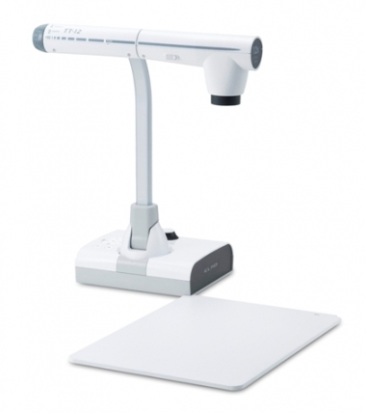
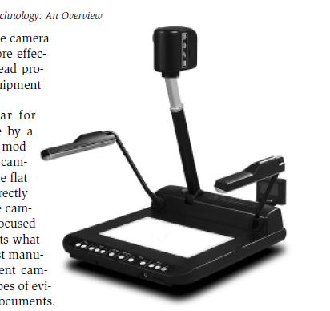
ELMO ™
Electricity Light Machine Organization
From ELMOUSA.com

Slide 17
Benefits of Elmo/Visualizer
Projects solid objects (guns or drugs)
Good for maps, x-rays, photo or diagram.
Can project pages from books.
Can mark up document real-time and project.
Can zoom/focus manually—not rely on assistance to zoom to parts of document.
If new documents (not scanned) appear at trial, can use to cross examine—show to jury.
Backup to computerized exhibit presentation.

Slide 18
Trial Director/Sanction
Eliminates Exhibit Notebooks
Real time, editing and highlighting of exhibits for emphasis.
Real time impeachment with transcripts.

Slide 19
Interactive Exhibit Demonstrations
Needs to be choreographed!
Need to practice.
Use a laser pointer.
Need to communicate well with technician/paralegal.
Poor Examples.

Slide 20
Pre-Prepared Exhibits
Use in Opening and Closing
Use on Direct Testimony
Use with Experts

Slide 21
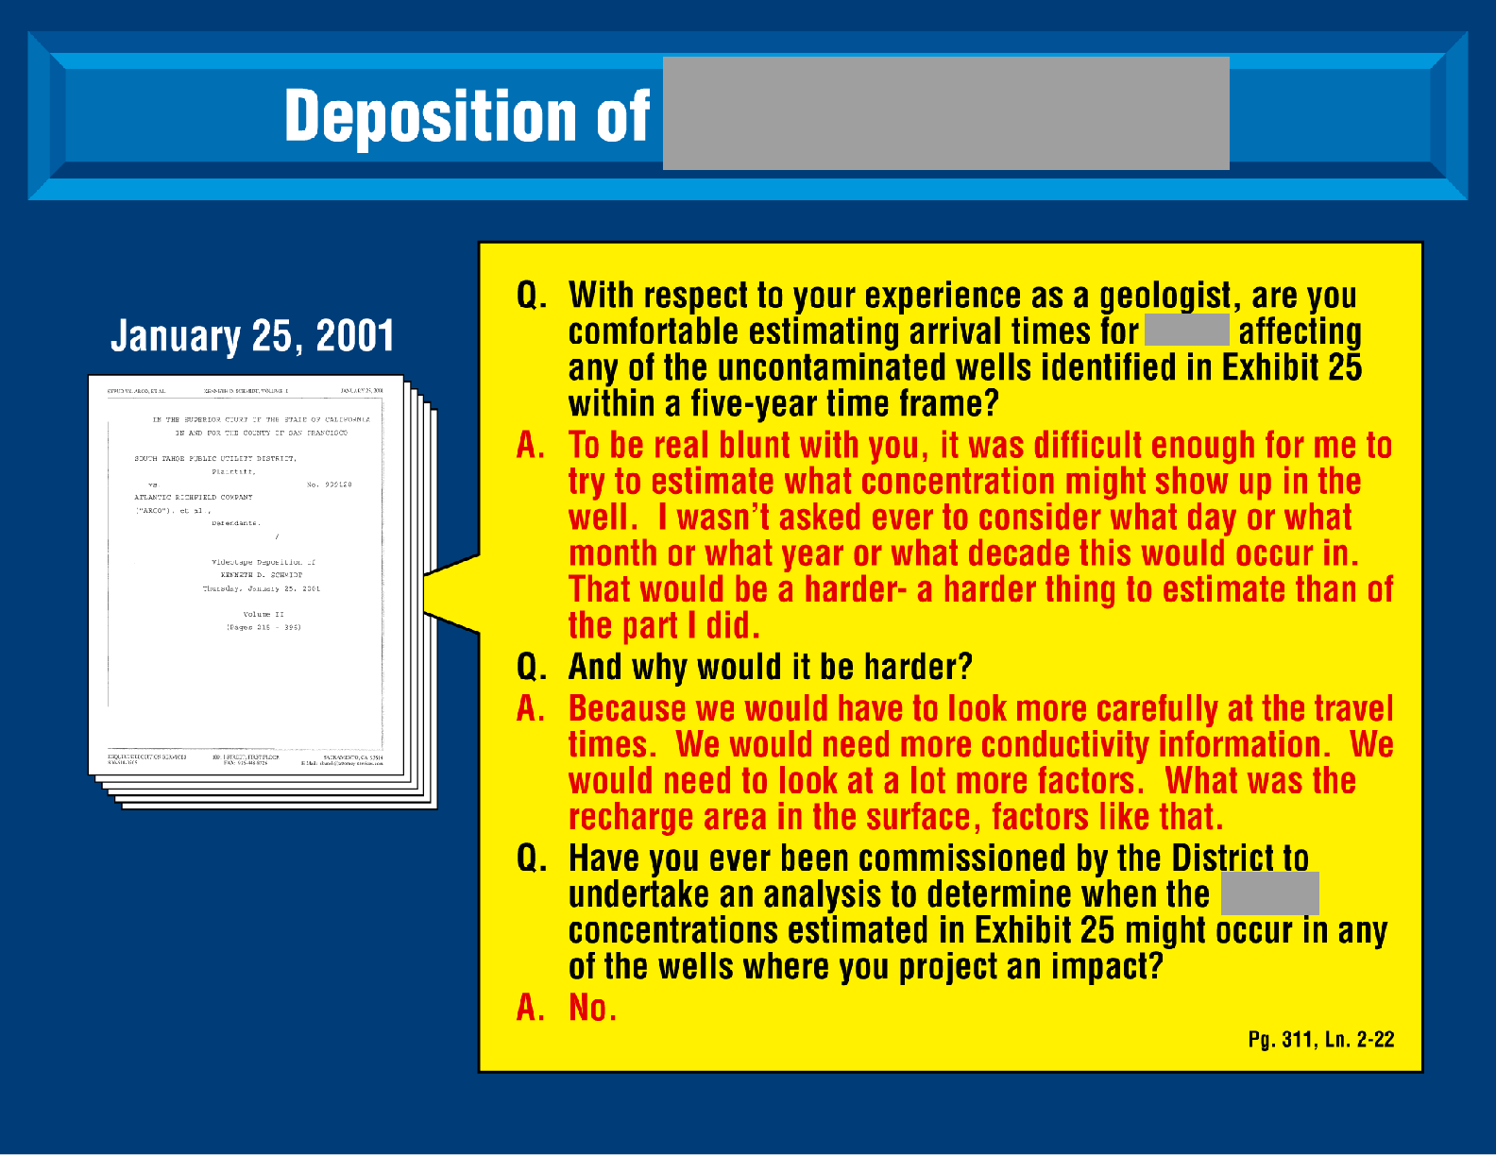

Slide 22
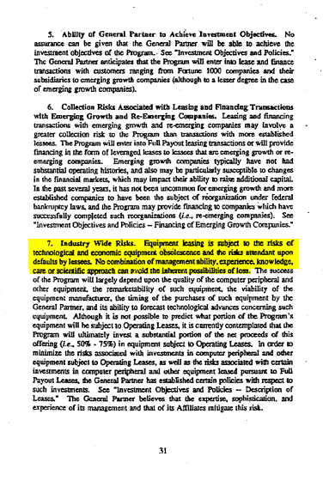
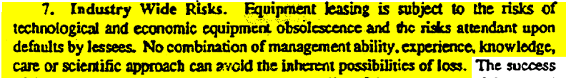

Slide 23
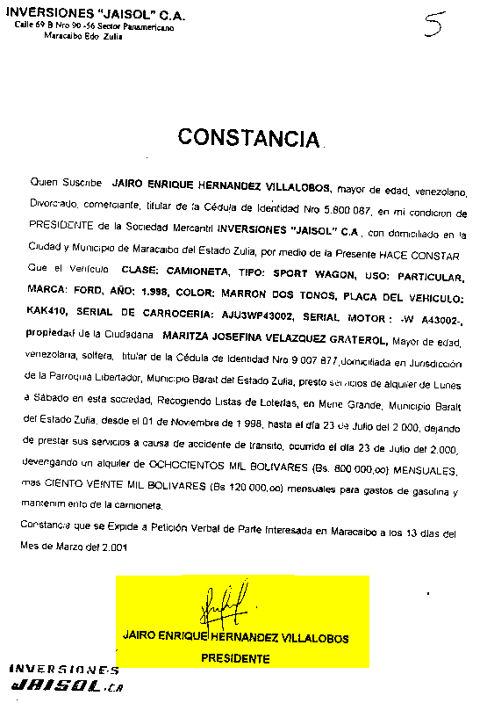

“Certification” by Inversiones Jaisol, C.A. President Jairo E. Hernandez Villalobos

Slide 24

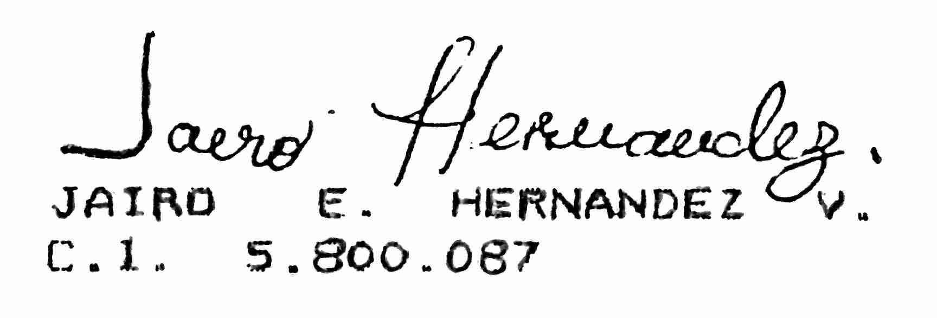
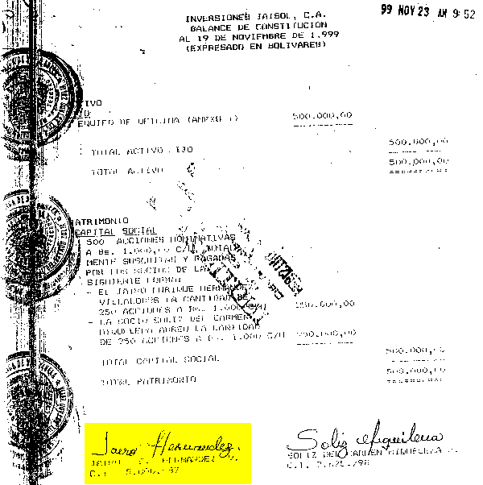
Two Different Signatures
(Jairo Enrique Hernandez Villalobos, President of “Jaisol”)
“Certification” by Inversiones Jaisol, C.A. President Jairo E. Hernandez Villalobos
November 1999 documents incorporating Inversiones Jaisol, C.A.

Slide 25
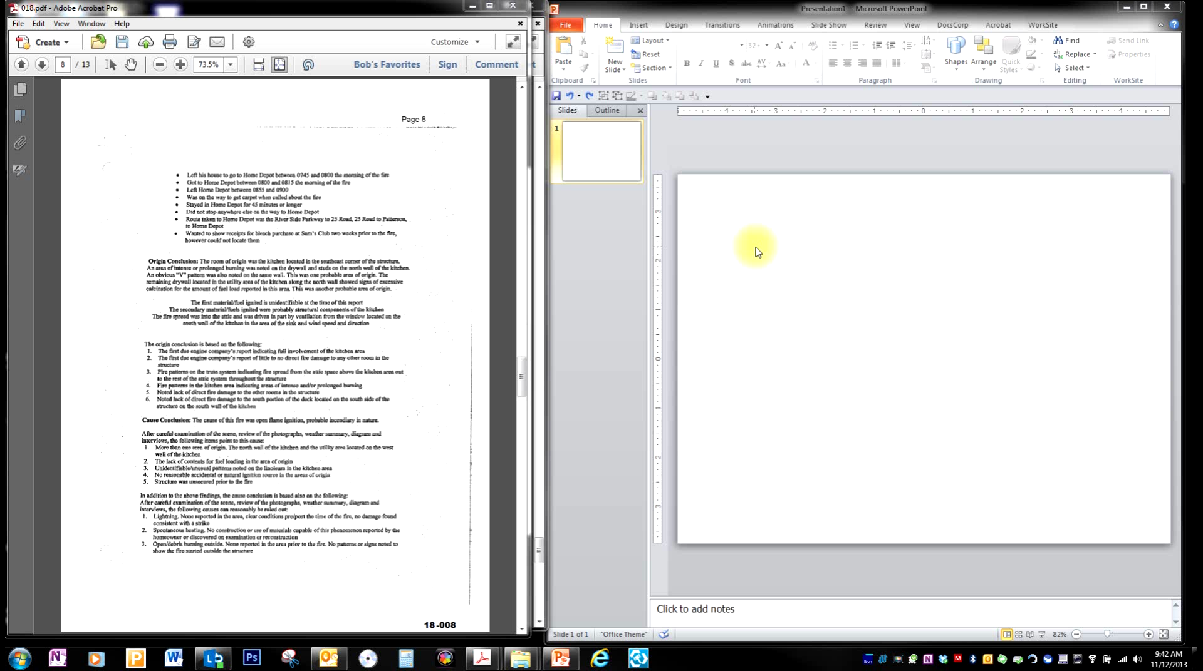

Slide 26
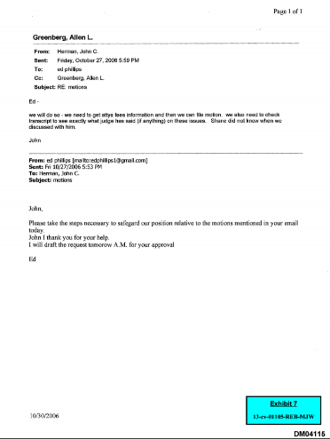
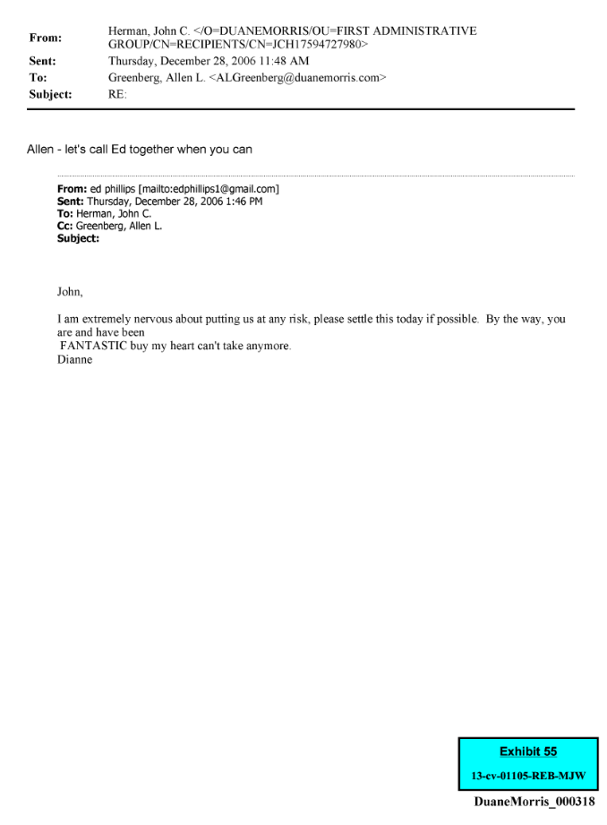
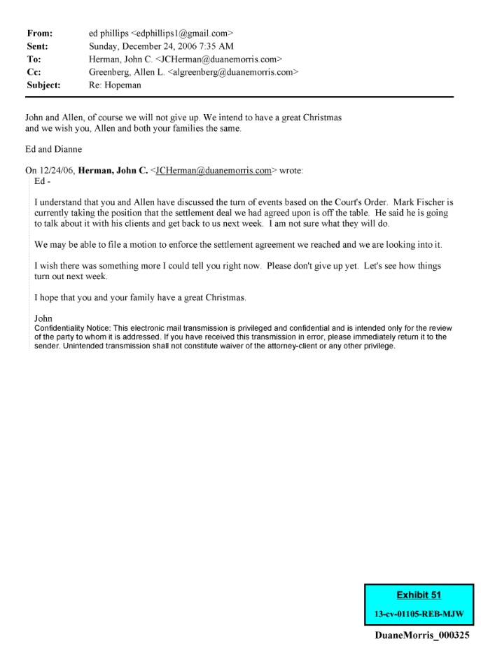
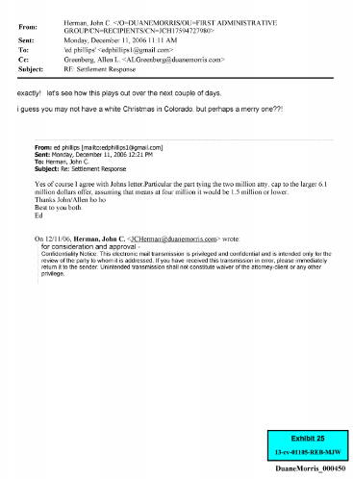


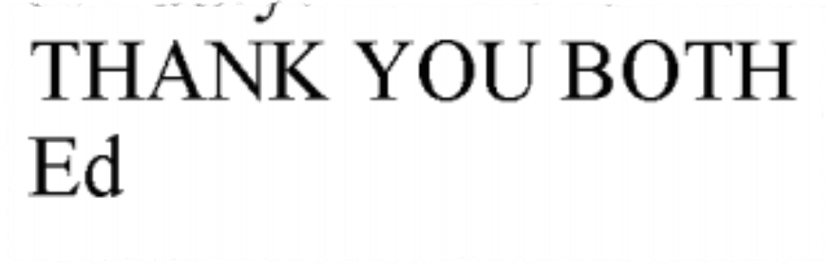
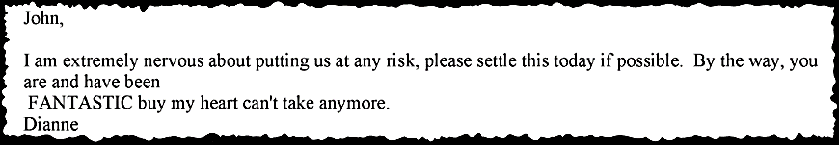
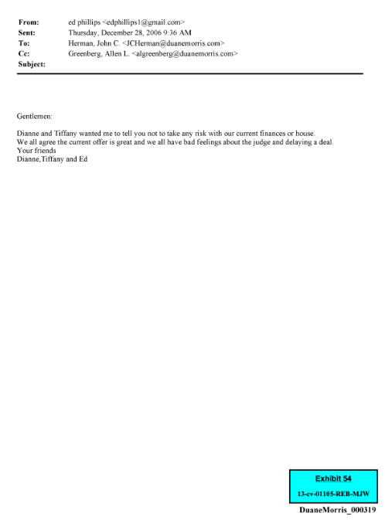

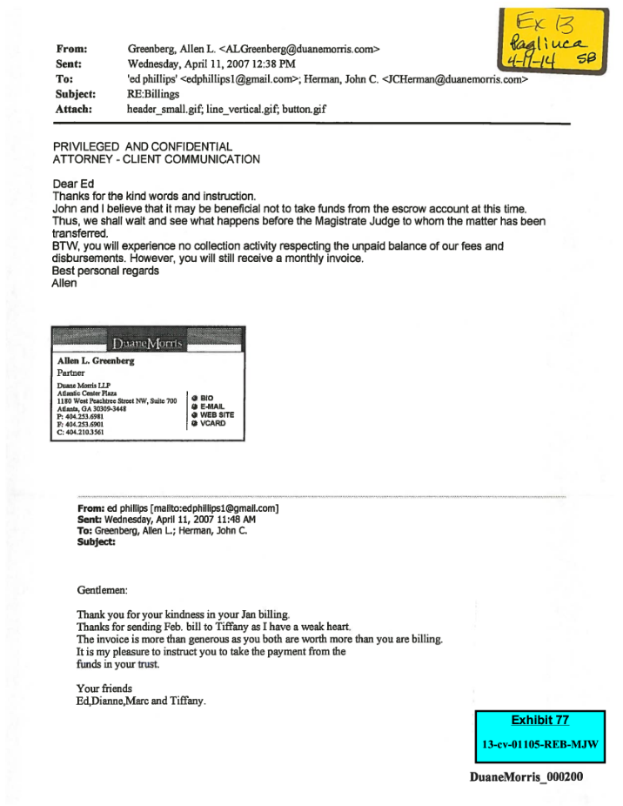
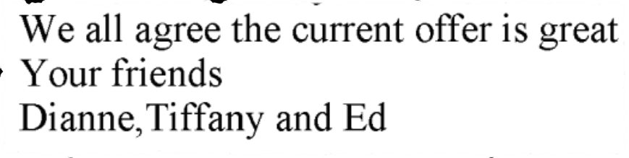
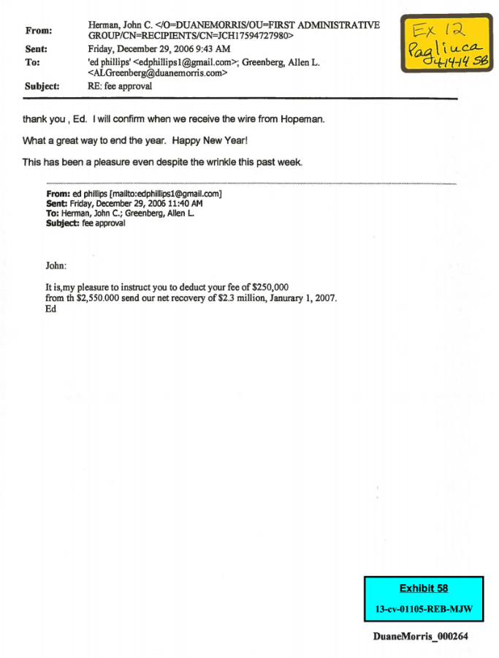

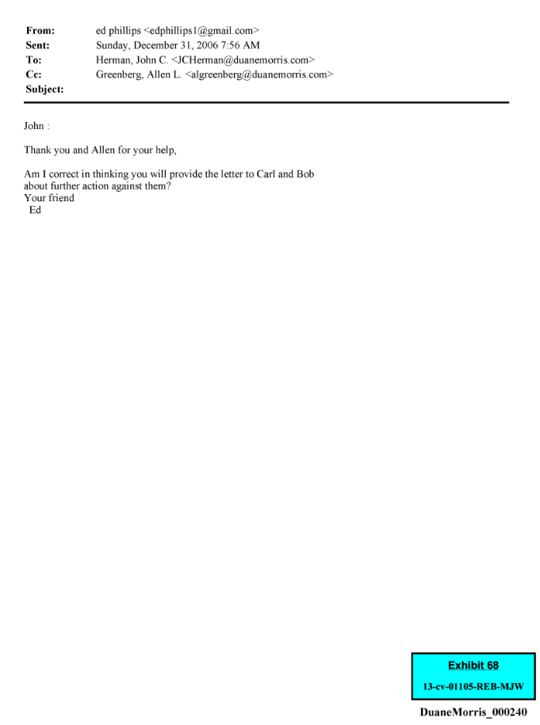
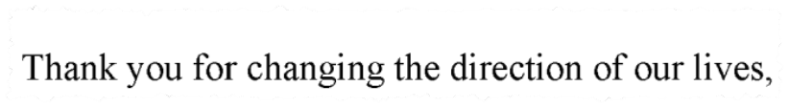

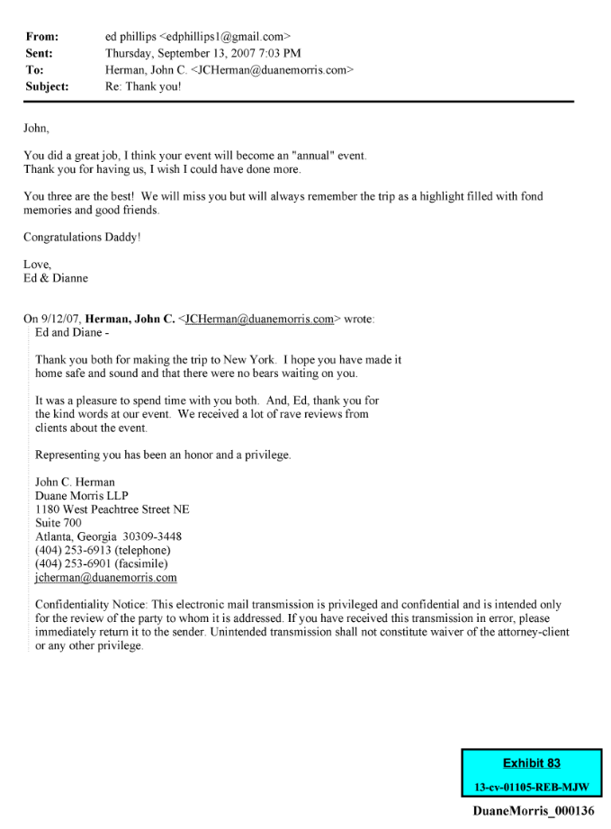

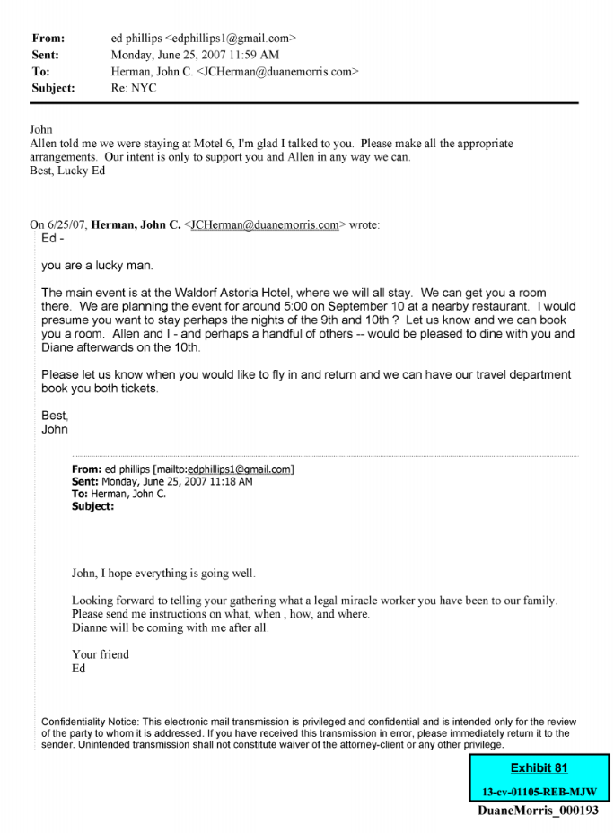
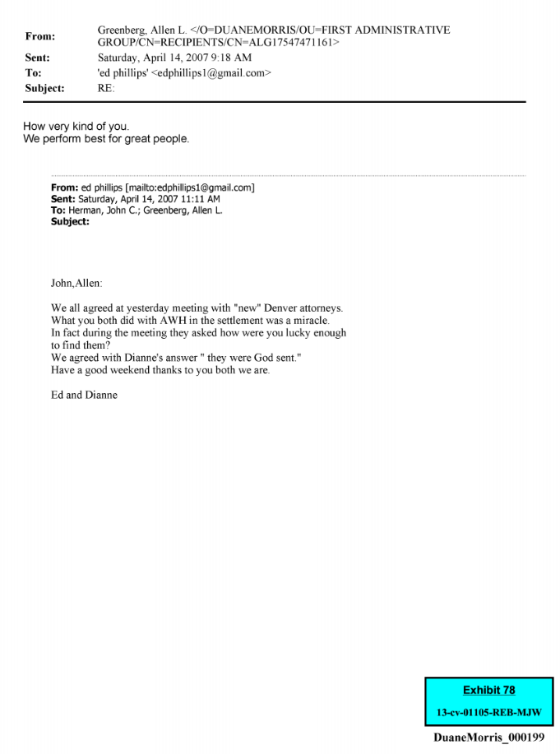
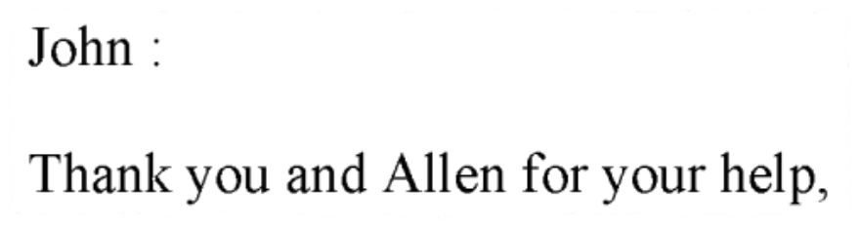
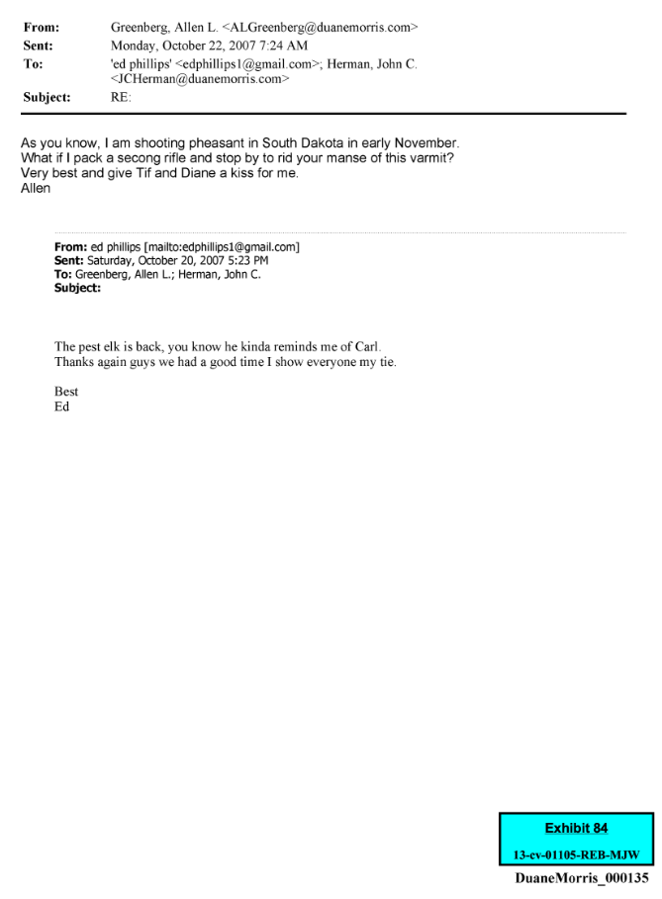
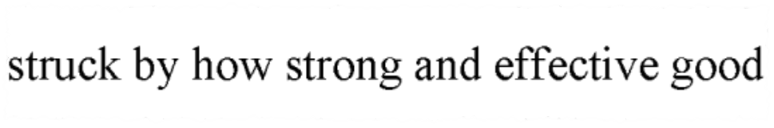



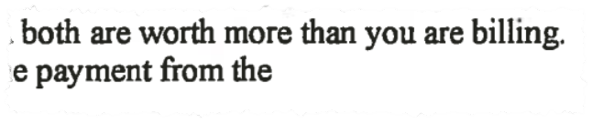
What ____ said before he sued his attorney
Ex. 25
Ex. 61
Ex. 55
Ex. 58
Dianne’s - Testimony:
“He was my angel”
Ex. 54
Ex. 75
Ex. 81
Ex. 78
Ex. 66
Ex. 75
Ex. 83
Ex. 78
Ex. 84
Ex. 77

Slide 27
Why Graphs/Charts Help:
Exploration: help to identify the key facts.
Explanation: help to effectively communicate the story.
(Picture worth 1,000 words)

Slide 28
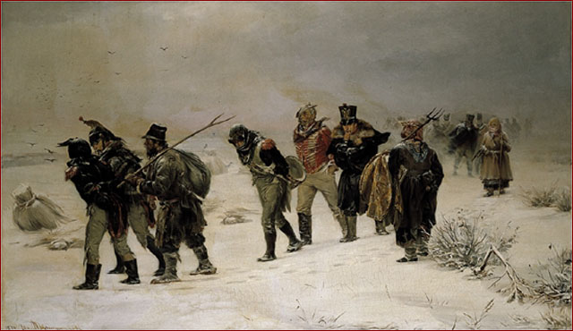
In 1812 by Illarion Prianishnikov

Slide 29
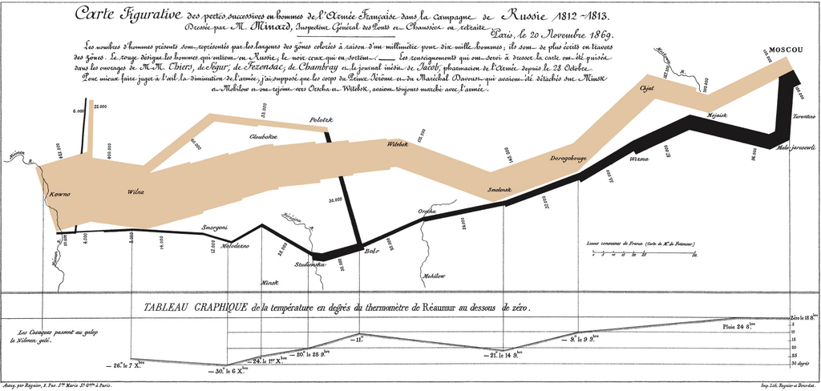
Chart by Charles Joseph Minard

Slide 31
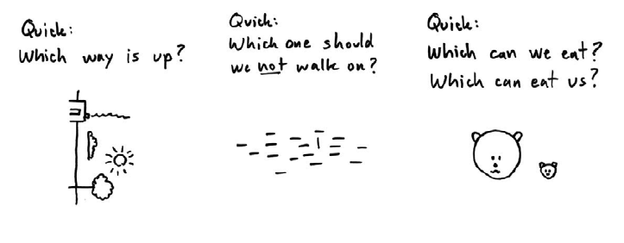
Images save time—facilitate understanding.
From the 10 ½ Commandments of Visual Thinking by Dan Roam.

Slide 32
Problem:
PURE NUMBERS ARE VISUALLY UNINTERESTING
PATTERNS, RELATIONSHIPS, CHANGES --- NOT READILY APPARENT.

Slide 33
Annual Sales
Year | Quantity | Change
1 | 9 | --
2 | 11 | +2
3 | 10 | -1
4 | 13 | +3
5 | 11 | -2
6 | 14 | +3
7 | 13 | -1
8 | 14 | +1

Slide 34
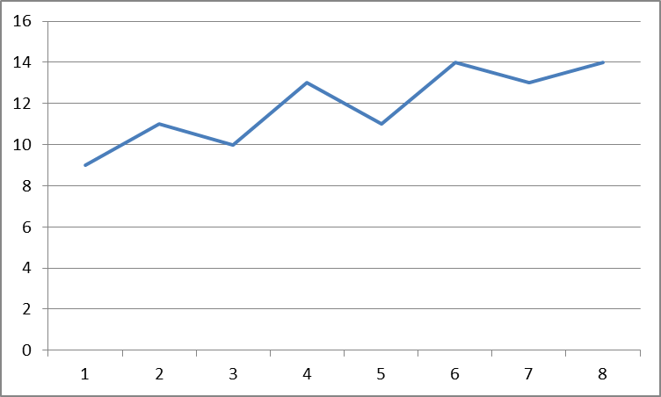
ANNUAL SALES FIGURES

Slide 35
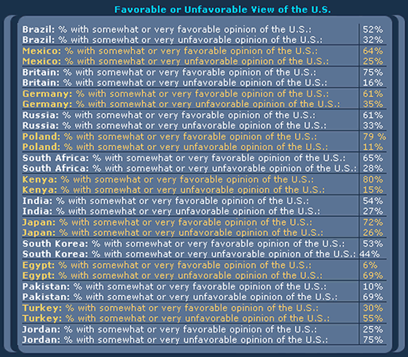

Slide 36
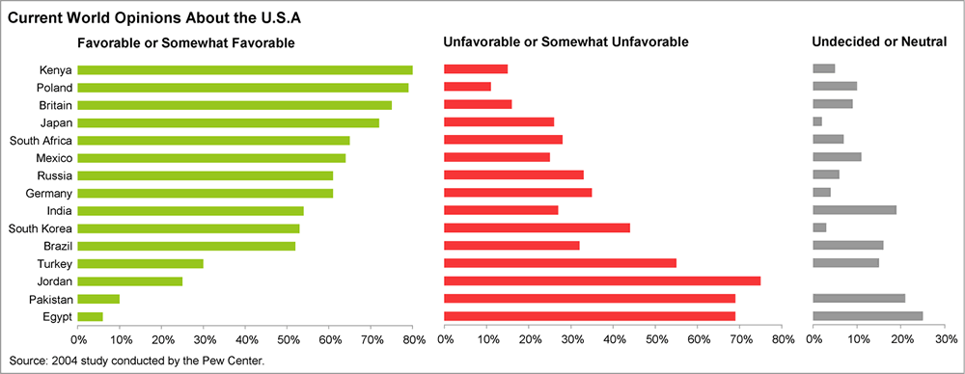
From: Perceptualedge.com
Stephen Few, Visual Business Intelligence Newsletter.

Slide 37
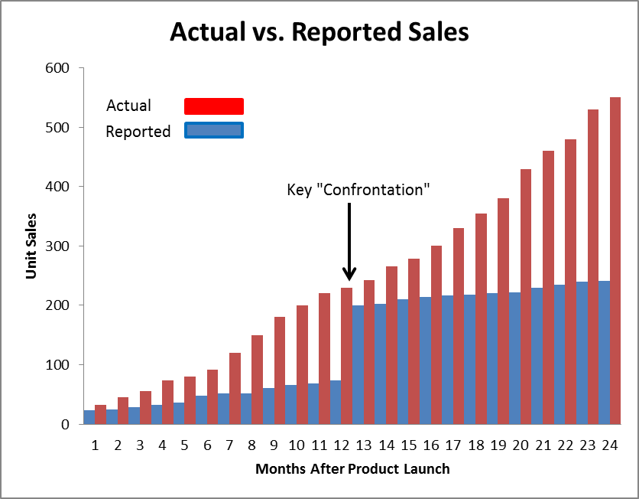
Contract Terminated

Slide 38
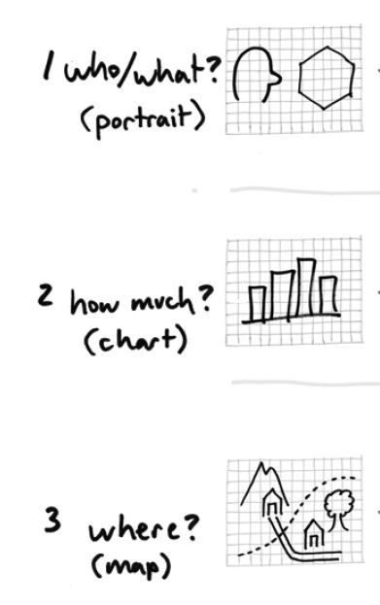
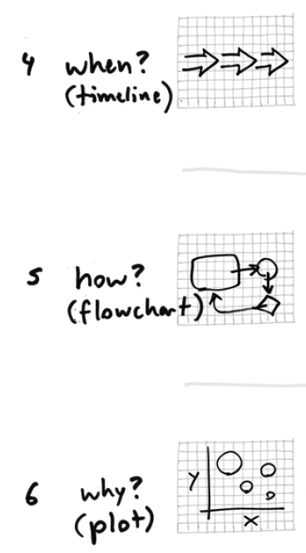
From:
Back of the Napkin:
Solving Problems and Selling Ideas with Pictures, by Dan Roam.
WHAT KIND OF VISUAL?

Slide 39
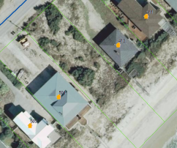
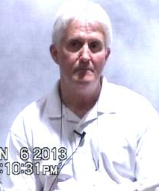
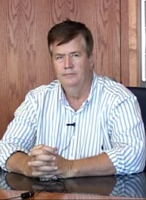
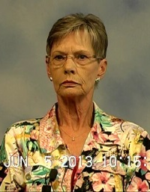
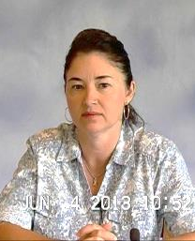
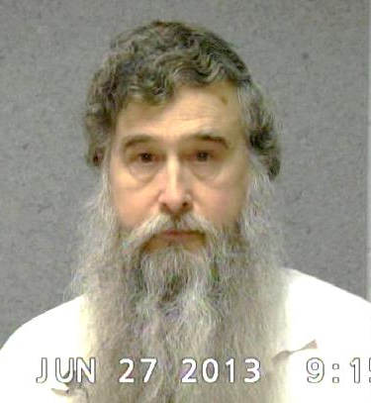
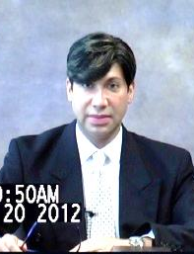
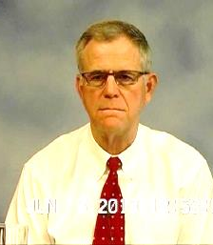
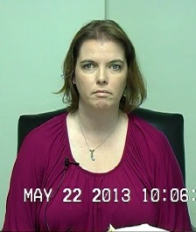
Cast of Characters
Holly Ouimette
John Worley
Darell Potthoff
Signature Forged and
Topsail Beach Property
Stolen by
ID’d Person in FCB Photos as
Wallet and ID Stolen by
Judy Crumpler
Roger G. Kornegay
a/k/a “John Worley”
Karen Scalf
Notary Seal Stolen and
Signature Forged by
ID’d Person in FCB Photos as
James Hines
(Victim and ORT Insured)
Gustavo Schmidt
Amy Penley
FCB Employee Who Disclosed
Photo Evidence of Banking Activities by
Misled Into Purchasing Stolen
Topsail Beach Property for $250,000 by
Misled into Recording
Forged Deed by

Slide 40
Tufte’s Principles of Graphical Excellence
Give to the viewer
  the greatest number of ideas
  in the shortest time
  with the least ink
  in the smallest space.
Multi-variable
Requires telling the Truth

Slide 41
HOW YOU PRESENT DATA
CAN REINFORCE OR DETRACT FROM
YOUR STORY
Example: Salesman Plaintiff fired for poor performance. Claims age discrimination.

Slide 42
Sales Over Time
Period | Quantity | Change
1 | 9 | --
2 | 11 | +2
3 | 10 | -1
4 | 13 | +3
5 | 11 | -2
6 | 14 | +3
7 | 13 | -1
8 | 14 | +1

Slide 43
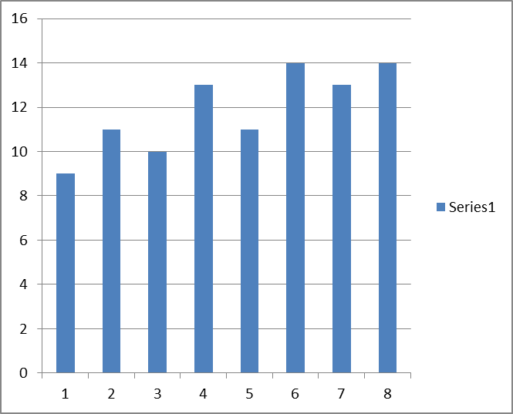
ANNUAL SALES

Slide 44
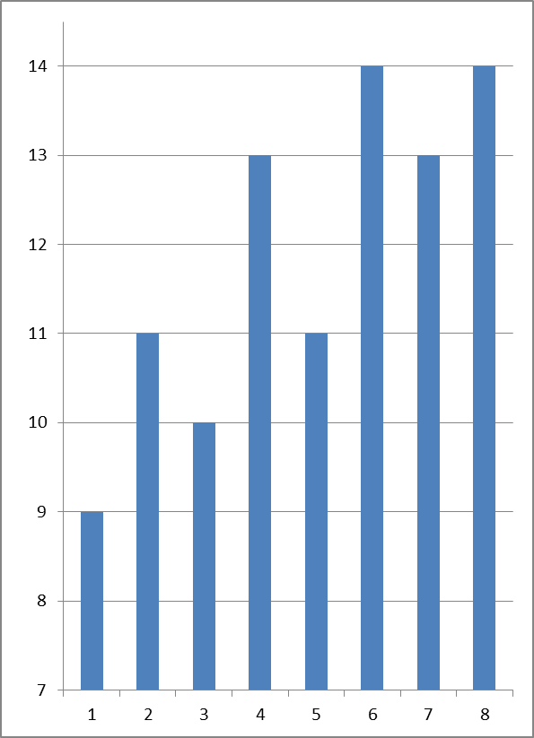
Plaintiff’s Annual Sales
(Plaintiff’s Version)
0

Slide 45
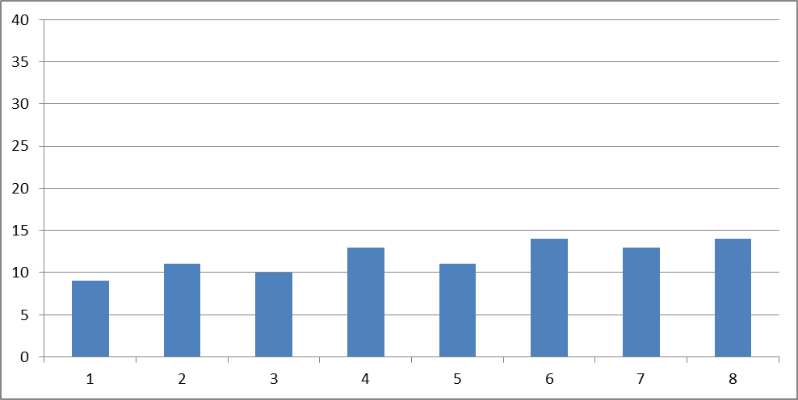
PLAINTIFF’S ANNUAL SALES
(Defense Version)

Slide 46


Slide 47
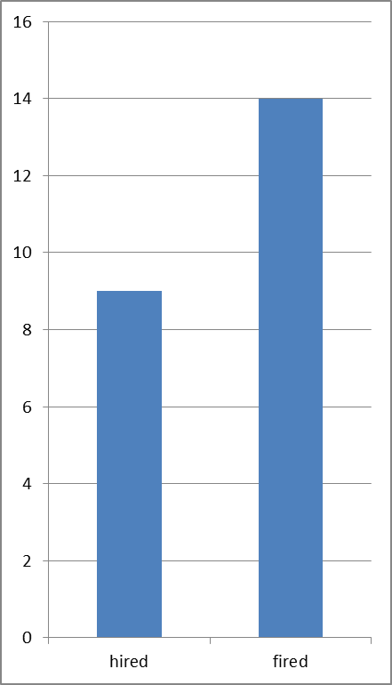
55 PERCENT INCREASE IN SALES FROM HIRING to FIRING

Slide 48

CHANGE IN ANNUAL SALES
(Potential Defense Version)

Slide 49
graphic needs to be part of telling a story—not just have data thrown on the screen
Must collaborate with graph/chart creator!

Slide 50
Telling the Truth
Graphic should not distort.
Visual representation should be consistent with numerical representation.
Misleading graphics -- basis for objection.
  Graphics can be admitted as summary under Evidence Rule 1006--not just a “demonstrative”. Do not jeopardize.
  Lose credibility.

Slide 51


Slide 52

If volume of barrels from 1973 to 1979 is to represent price change, then the volume from ’73 to ’79 increase 27,000 percent, compared to a data increase of 454 percent.
From Tufte—Visual Display of Quantitative Information

Slide 53


Slide 54

http://www.perceptualedge.com/example15.php

Slide 55

PIE CHARTS? NOT HELPFUL!
Positive: Indicates nature of Relationship—part to the whole.
Negative: Does not represent quantities accurately
Negative: Unable to easily compare quantities.
Negative: Unable to see ranked order of values.

Slide 56


Slide 57
The Malignant Evil
of Computer Generated Graphs/Charts
2 | 12 | 19
4 | 10 | 18
6 | 8 | 16
5 | 11 | 14
3 | 13 | 11
1 | 16 | 8
0 | 19 | 4
4 | 14 | 6
8 | 13 | 8
11 | 10 | 13
13 | 8 | 13
19 | 4 | 12

Slide 58


Slide 59


Slide 60


Slide 61


Slide 62





Slide 63
Working with Experts
Begin discussing early!
As important as written report.
Rule requires disclosure with expert report, of “any exhibits to be used as a summary of or support for the opinions” – Rule 26(a)(2)(B)(I)
Experts sometimes don’t think about graphic quality.

Slide 64


Slide 65
CHRONOLOGIES
REALLY HARD TO DO WELL
PROBLEMS
  TOO MUCH INFORMATION
  INABILITY TO EMPHASIZE IMPORTANT EVENTS
TIP: FIGURE OUT POINT TRYING TO COMMUNICATE

Slide 66

Pap Smears, Cervical Biopsy & Hysterectomy

Slide 67


Slide 68
Conclusion
THINK ABOUT VISUALLY PRESENTING YOUR CASE FROM THE VERY BEGINNING
GET GRAPHICS PERSON INVOLVED EARLY IN PROCESS
EDIT, REVISE, EDIT, REVISE
THINK ABOUT MOCK TRYING YOUR EXHIBITS—USE JURY CONSULTANT TO GET SECOND OPINION
GET WITH EXPERTS EARLY TO REVIEW PROPOSED CHARTS/GRAPHS

