Slide 1
COLAP Presents:
Here to Help
The Colorado Lawyer Assistance Program
Chip Glaze, JD, LMFT
Deputy Director
Faculty of Federal Advocates CLE
August 16, 2019

Slide 2
The Practice of Law is NOT Stress Free

Slide 3
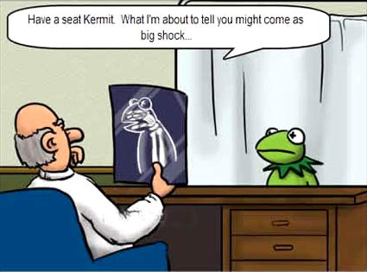
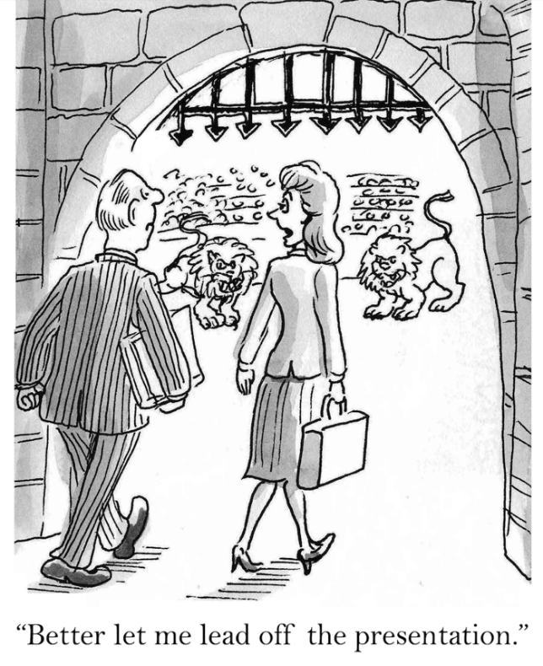
“Bad News” Business

Slide 4
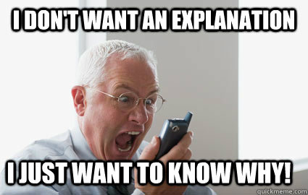
Reactions – Clients
Oh yeah,
I got your
%#@! bill!!
No?!?

Slide 5
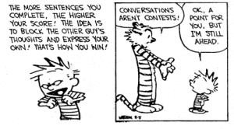
Reactions – Attorneys

Slide 6
Rarely, if ever
(see also: Rainbow Unicorn)

Slide 9
Secondary Trauma
aka Vicarious Trauma; Compassion Fatigue
Lesser recognized, but detrimental

Slide 10
Stress & Burnout

Slide 11
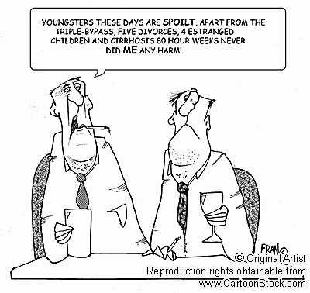
Sound Familiar?

Slide 12
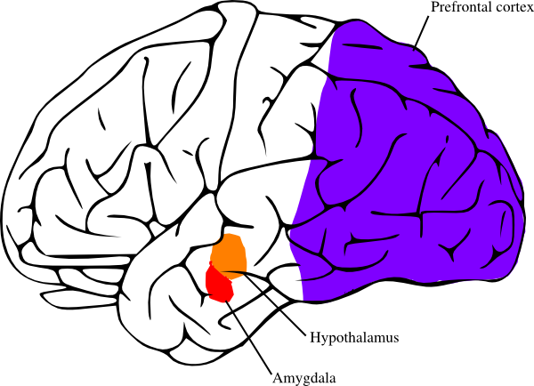
Understanding the Natural Stress Response
When you encounter a perceived threat …your hypothalamus, a tiny region at the base of your brain, sets off an alarm system in your body. Through a combination of nerve and hormonal signals, this system prompts your adrenal glands, located atop your kidneys, to release a surge of hormones, including adrenaline and cortisol.
https://www.mayoclinic.org/healthy-lifestyle/stress-management/in-depth/stress/art-20046037

Slide 13
Executive functions (EFs) make possible mentally playing with ideas; taking the time to think before acting; meeting novel, unanticipated challenges; resisting temptations; and staying focused. Core EFs are inhibition…interference control…working memory, and cognitive flexibility. https://www.ncbi.nlm.nih.gov/pmc/articles/PMC4084861/
ie – Why clients engage lawyers’ services

Slide 14
When the Natural Stress Response Goes Haywire
The body's stress-response system is usually self-limiting. Once a perceived threat has passed, hormone levels return to normal. As adrenaline and cortisol levels drop, your heart rate and blood pressure return to baseline levels, and other systems resume their regular activities.
But when stressors are always present and you constantly feel under attack, that fight-or-flight reaction stays turned on.
https://www.mayoclinic.org/healthy-lifestyle/stress-management/in-depth/stress/art-20046037

Slide 15
This area is compromised, or completely “offline”
When this area is constantly operating at some level of “fight or flight”

Slide 16
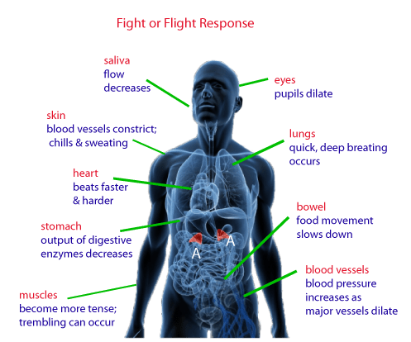
This time, it’s really not “all in your head”
Stress Resilience with Paul Campbell
https://www.startups.com/library/videos/series/stress-resilience

Slide 17
Potential Long Term Physical Consequences:
The long-term activation of the stress-response system — and the subsequent overexposure to cortisol and other stress hormones — can disrupt almost all your body's processes. This puts you at increased risk of numerous health problems, including:
­- Anxiety - Depression
- Digestive problems - Headaches
- Heart disease - Sleep problems
- Weight gain - Memory and concentration impairment
“That's why it's so important to learn healthy ways to cope with the stressors in your life.”
https://www.mayoclinic.org/healthy-lifestyle/stress-management/in-depth/stress/art-20046037

Slide 18
How are “we” doing?
More importantly, how are you doing?

Slide 19
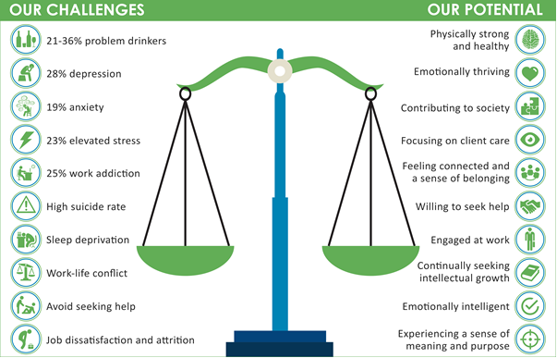
THE REPORT OF THE NATIONAL TASK FORCE ON LAWYER WELL-BEING

Slide 20
20.6% of attorneys responding drink problematically, as compared to 11.8% of a broad, highly educated workforce screened positive on the same measure. For attorneys under age 30 the percentage is even higher; 28.9%.
Illicit substance use and the misuse of prescription medications are also a concern.
Co-occurring Disorders
http://www.hazeldenbettyford.org/about-us/news-media/press-release/2016-aba-hazelden-release-first-study-attorney-substance-use

Slide 21
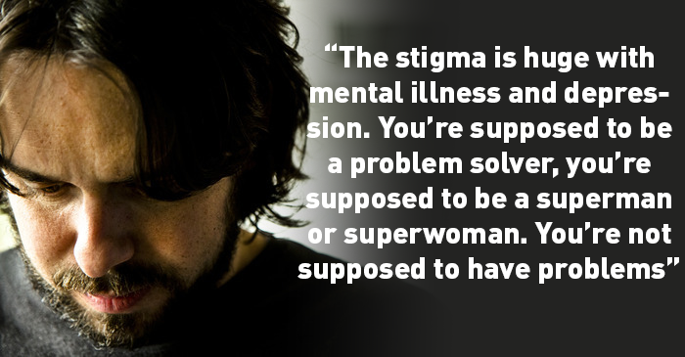
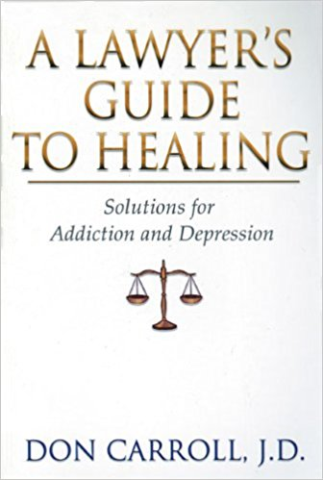
28%, 19%, and 23% of attorneys reported experiencing symptoms of depression, anxiety, and stress, respectively.
http://www.hazeldenbettyford.org/about-us/news-media/press-release/2016-aba-hazelden-release-first-study-attorney-substance-use

Slide 22
What is lawyer “well-being”?
THE REPORT OF THE NATIONAL TASK FORCE ON LAWYER WELL-BEING

Slide 23
If/When you need help:

Slide 24
Colorado Lawyer Assistance Program (COLAP)
What: Confidential, Independent program
Created by CO Supreme Court Rule 254
Where: Location: I-25 & Speer, West Side
When: By appointment
Call or email anytime
How: Assistance with personal and professional issues, referrals to therapy/treatment, presentations, articles, volunteers

Slide 25
Why Contact COLAP?
Presentations
Stress management issues
Relationship issues - family, co-workers, difficult clients, etc.
Concern for a colleague
Grief issues
Referrals for therapy/treatment
Mental health or substance use issues
Transitions - job/career change, retirement
“Just need to talk”

Slide 26
COLAP Services Are:
Confidential
Voluntary
No Charge
“Broadbrush” services
COLAP services are available to ALL lawyers, Judges, law students, and bar applicants
COLAP IS NOT ATTORNEY REGULATION

Slide 27
For Confidential Assistance:
303.986.3345
or
For More Information:
www.coloradolap.org

